Slide 1

Presentation at the second register symposium
Mikkel Porsborg Andersen
Ph.D, MSc.Public Health, BSc.Sports Science
Seniorforsker og Specialkonsulent i Datamanagement
Nordsjællands Hospital
E-mail: mikkel.porsborg.andersen@regionh.dk

Slide 2
Overview
Data and setup at Statistics Denmark (DST)
Reduction of project folders
Data delivery from Danish Health Data Authority (SDS)
Approval and approval number for the project folders
Running cost and economy
Questions or comments
“Tell me and I forget, teach me and I may remember, involve me and I learn.”
Benjamin Franklin
Slide 1 of 8

Slide 3
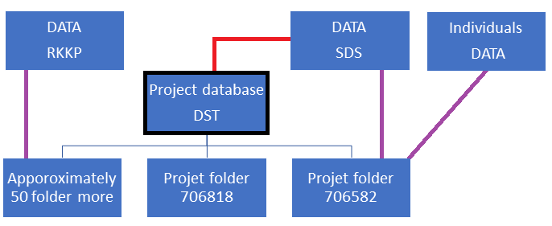
Data and setup at Statistics Denmark (DST)
Approximately 250 users
Project folder structure
Data flow
Folder population
Reduce data
No automatic update
Links are below
Heart.dk
Github
Slide 2 of 12

Slide 4
Reduction of project folders
The cost in relation to project folder updates has increased
Minimizing the project folders to the following folders
3573 – Projektdatabase
3740 – Cancerrisiko og hjerterisiko ved diabetes
3775 – Sundhed og sygdom hos kvinder og børn
3826 – Operationer og ulykker
6130 – Prognose og følgesygdomme efter cancer
6582 – Inflammatorisk Sygdom
6734 – Genetik, iskæmisk hjertesygdom og Diabetes
6818 – Hjertekarsygdom - Sygdomsbehandling og kardiovaskulære risiko
7089 – Hjertestop udenfor hospital – ESCAPE-NET
Slide 3 of 12

Slide 5
Reduction of project folders
Choice of new project folder
Depend on the study question
Aim of the project folder
Project folder description can be found on GitHub
Slide 4 of 12

Slide 6
Reduction of project folders
Moving of codes between folders (Link)
One SAS, R, STATA program
The path the program is to be moved from
The path where the program is to be moved to
The names of the researchers who have checked the program
Slide 5 of 12

Slide 7
Reduction of project folders
Moving of individual dataset or RKKP dataset
Make a copy of dataset on the X-drive and move it to the Z-drive
The path the dataset is to be moved from
The path where the dataset is to be moved to
The original approval or approvals
Slide 6 of 12

Slide 8
Data delivery from Danish Health Data Authority (SDS)
Data delivery to the project database
The application process took 1.5 years
The data delivery included the following registries:
Cancerregisteret (CAR)
Det Psykiatriske Centrale Forskningsregister (PCR)
Dødsårsagsregisteret (DAR)
Landsdækkende Register for Patologi (PAT)
Medicinsk Fødselsregister (MFR)
Landspatientregisteret – midlertidig datamodel (LPR3_SB)
Landspatientregisteret (LPR)
Landspatientregisteret - Psykiatri (LPR-PSYK)
Laboratoriedatabasens Forskertabel (LAB)
Plejehjemsadresser (PLH)
Slide 7 of 12

Slide 9
Data delivery from Danish Health Data Authority (SDS)
Before the data can be used under the project folders
A new application for each project folder must be sent to SDS
Waiting time are at least 6 months
Applications are therefore in progress with coordinator names below
3573 – Data received
3740 – Henrik Enghusen Poulsen
3775 – Application submitted to SDS
3826 – Missing coordinator
6130 – Christian Torp-Pedersen/Mikkel Porsborg Andersen
6582 – Kristian Kragholm/Mikkel Porsborg Andersen
6734 – Missing coordinator
6818 – Matthew Phelps/Gunnar Gislason
7089 – Carl Johann Hansen/Jacob Tfelt
Slide 8 of 12

Slide 10
Approval and approval number for the project folders
The Danish Data Protection Agency do not approve projects
The term umbrella approval (paraplygodkendelse) is not valid anymore
Confusion on what to write in the ethics section of an article
In Denmark register-based studies that are conducted for the sole purpose of statistics and scientific research do not require ethical approval or informed consent by law [ref]. However, the study is approved by the data responsible institute (Capital Region of Denmark - Approval number: P-2019-XXX) in accordance with the General Data Protection Regulation (GDPR).
[ref]. Andersen MP, Valeri L, Starkopf L, et al. The Mediating Effect of Pupils’ Physical Fitness on the Relationship Between Family Socioeconomic Status and Academic Achievement in a Danish School Cohort. Sports Med 2019;49(8):1291–301.
Slide 9 of 12

Slide 11
Approval and approval number for the project folders
All project folders have their own approval and approval number
The XXX must be changed in accordance too the project folder where the study was conducted
To see the different approvals, follow this link
Project folders: | Approval numbers:
703716 | 398
703740 | 393
703775 | 280
703826 | 404
706130 | 358
706322 | 537
706336 | 401
706582 | 191
706734 | 202
706818 | 348
707089 | 527
Slide 10 of 12

Slide 12
Running cost and economy
Increased expenses for running the network
Funding applications
Apply for 20.000kr pr. year for running costs towards DST expenses
Slide 11 of 12

Slide 13

Questions or comments
Slide 12 of 12

